Slide 1
Hospital Database
Julian, Dominic, Chris, Geeta, David, James

Slide 2
Backstory
Hospital uses traditional paper file system for all their information
Takes up space
Hard to organize
Time consuming to search through
More susceptible to human errors

Slide 3
Proposal
Electronic Database system
Easily organized and edited
Quickly accessible and shared
Easier to maintain and manipulate
Requires less physical space
Records cannot get misplaced
Reduces paper consumption
Automatic Report Generation

Slide 4
Budget
System Administrator would require $60,000 – $80,000 per year
$1,560 per year to run and maintain database server

Slide 5
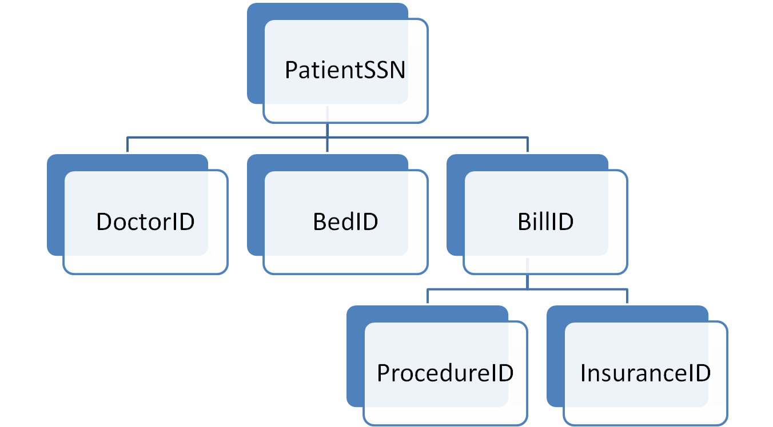
Patient Perspective

Slide 6
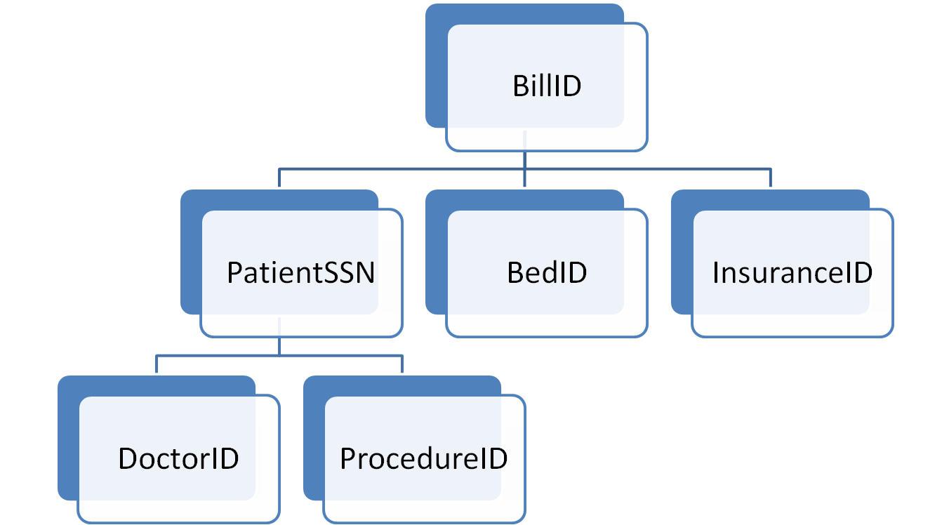
Hospital Perspective

Slide 7
